Slide 1

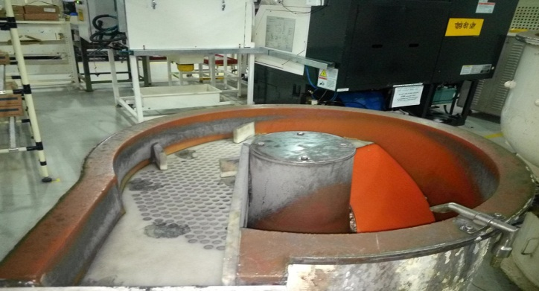
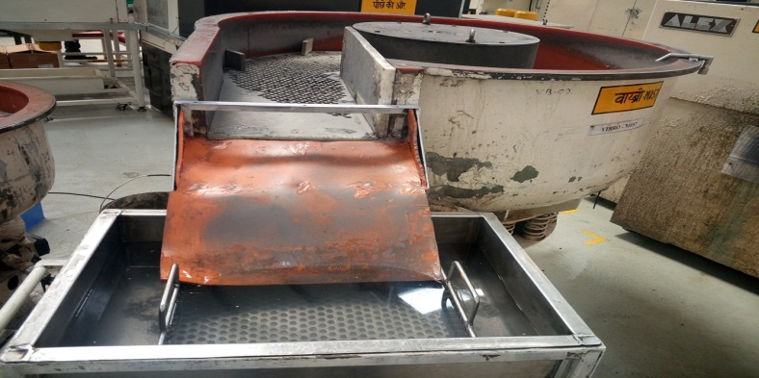
AHPL/QMS/FR/09/E
P15
KAIZEN NO :-
ACTIVITY
KK
QM
PM
JH
SHE
OT
DM
E&T
KAIZEN IDEA SHEET
TPM CIRCLE NAME:
LOSS NO. / STEP
DEPT :- MACHINE SHOP
RESULT AREA
P
Q
A,B,C
C
D
S
M
CELL:- Grinding
CELL NAME:- Rotor cell
MACHINE / STAGE : Vibro machine
OPERATION :- Burr removing and cleaning.
KAIZEN THEME : To Reduce Rejection for Dent Damage. & avoid shop floor fallen job
IDEA :- Vibro machine output location provide slope type rubber attachment.
Problem / Present Status :-
In Vibro machine Rotor get damage due to fallen in shop floor and direct drop in tray.
COUNTERMEASURE:- Vibro machine output rotor slide on slope type rubber attachment and drop in water tray.
BENCHMARK
Avoid dent damage
TARGET
Reduce dent rejection
KAIZEN START
10.05.2017
TDC
28.05.2017
KAIZEN FINISH
27.05.2017
TEAM MEMBERS :
1.Santosh Deshmukh.
2.Sandip Jagtap
BENEFITS :-
1. Reduce dent damage rejection .
2. Avoid rotor fallen in floor.
Before
After
KAIZEN SUSTENANCE
WHY - WHY ANALYSIS :-
Why1 :- Vibro machine output material direct drop in output tray.
Why2:- Rotor Spread on floor during unloading.
Why3 :- Distance between machine output and tray is more .
Why4 :-Due gravitational force increase rotor drop speed.
RESULT :-
Avoid rotor dent during unloading.
Avoid rotor fallen in shop floor.
House Keeping Improve.
Reduce dent damage rejection.
Avoid rotor mix up in output tray.
WHAT TO DO:- Vibro machine output location in fitted slope type rubber attachment.
HOW TO DO:- N.A
ROOT CAUSE :- Vibro machine out put material direct drop in output tray with gravitation force.
REGISTRATION NO. & DATE :
SCOPE & PLAN FOR HORIZONTAL DEPLOYMENT
REGISTERED BY :- Santosh Deshmukh.
SR.
NO.
CELL
TARGET
RESPONSIBILITY
STATUS
MANAGER’S SIGN :- D. Y. Pawar
1
---
------
-----
----
Rev. no: 01 Rev . Date:15.12.2016

